Slide 2
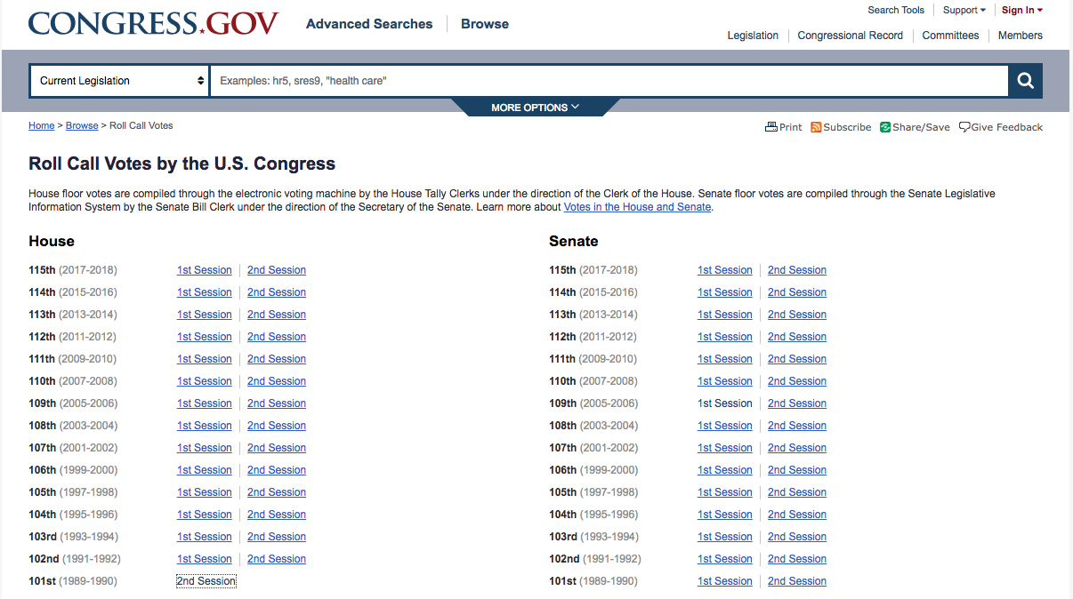
Data Collection
Roll Call Votes are listed by chamber, year, and session.

Slide 3
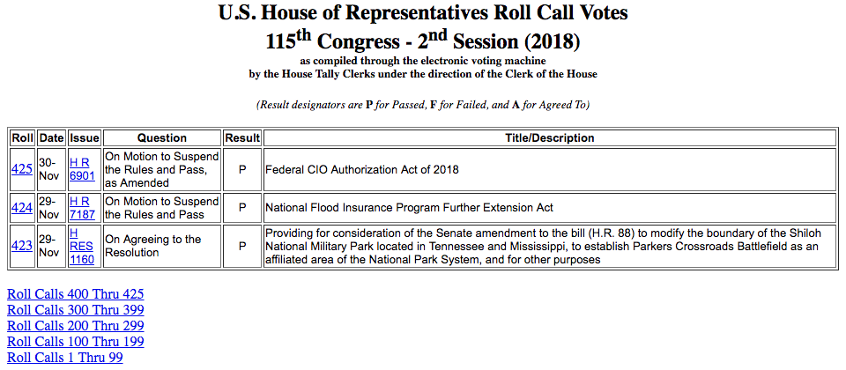
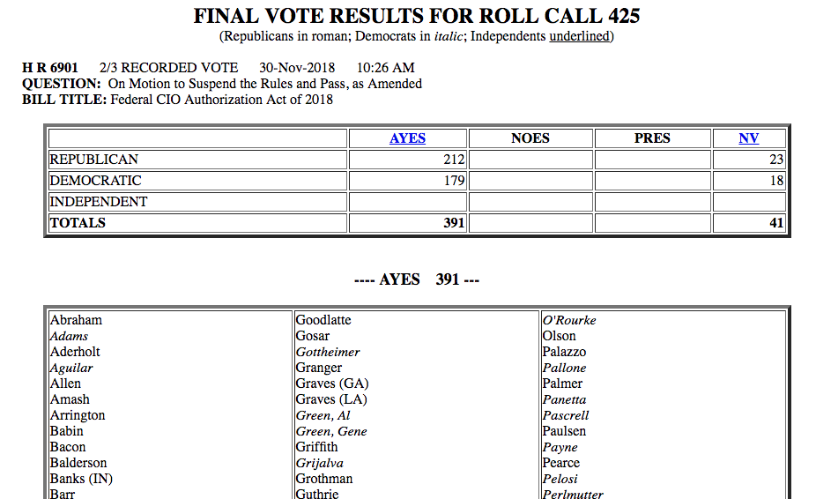
Data Collection
Roll Call Vote summaries are listed in tabular form.
This data was scraped, stored, and formatted.
Roll Call results are listed at the link provided at each Roll number.
This data was also scraped, stored, and formatted.

Slide 4
Data Collection
Roll Call Votes are listed by chamber, year, and session.

